Slide 1


E-Commerce Website
(Trends)

Slide 2
Group
Group No:4
Team Member and Roll No.
Member 1: Aryan(2210990175): Responsible for the basic structure of the website and for helped in future working and styling of ppt.
Member 2: Ashish Tantubai(2210990188): Responsible for the working part and added other features to make it more good and helped in making ppt .
Member 3: Avinash Kumar Jha(2210990200): Responsible for the styling and working part and helped for further development of website and ppt.

Slide 3
Index
Introduction
Objective
Algorithm
Summary
Result
Source Code (snapshots)
Reference
Conclusion

Slide 4

Introduction
Welcome to Trends, the epitome of modern online shopping! In this digital era, we present a virtual marketplace where convenience meets choice. Let's embark on a journey through our e-commerce platform, designed to redefine your shopping experience.

Slide 5
Objective
The primary objective of this e-commerce website is to facilitate online buying and selling of products or services, providing a seamless and user-friendly experience for customers. This includes features such as easy navigation, product information, and efficient order processing. Additionally, e-commerce sites aim to build trust, enhance customer satisfaction, and ultimately drive sales and business growth.

Slide 6
Techniques
1.*HTML Structure:*
- Create HTML files for the main pages (e.g., home, product, cart).
- Structure the HTML with elements for headers, footers, navigation, and content areas.
2. *CSS Styling:*
- Style the website using CSS for a visually appealing layout.
-Ensure responsiveness for different screen sizes using media queries.
3. *Product Details Page:*
- Create a product details page with HTML.
- Style the page using CSS to showcase detailed product information.
4. *Shopping Cart:*
Implement a simple shopping cart using HTML for the cart page.
- Use CSS to style the cart and make it visually intuitive.

Slide 7
Algorithm
5. *Add to Cart Functionality:*
- Implement JavaScript to add products to the cart dynamically.
- Update the cart total and item count using HTML and CSS.
6. *Local Storage:*
- Use JavaScript to store cart data in local storage, allowing persistence between page visits.
7. *User Feedback:*
-Implement simple user feedback messages using JavaScript.
Enhance user experience with visual cues for successful actions.
8. *Continuous Improvement:*
- Gather user feedback and make iterative improvements using HTML, CSS, and JavaScript.

Slide 8
Summary
This project involves creating a user-friendly online shopping platform using HTML, CSS, and JavaScript. Key steps include defining objectives, conducting market research, selecting a tech stack, implementing frontend development, ensuring security and performance, testing and deployment, analyzing analytics for continuous improvement, and executing a strategic launch and marketing plan. This comprehensive approach ensures the development of a responsive, visually appealing, and secure e-commerce website, meeting user needs and industry standards.

Slide 9

Snapshots

Slide 10
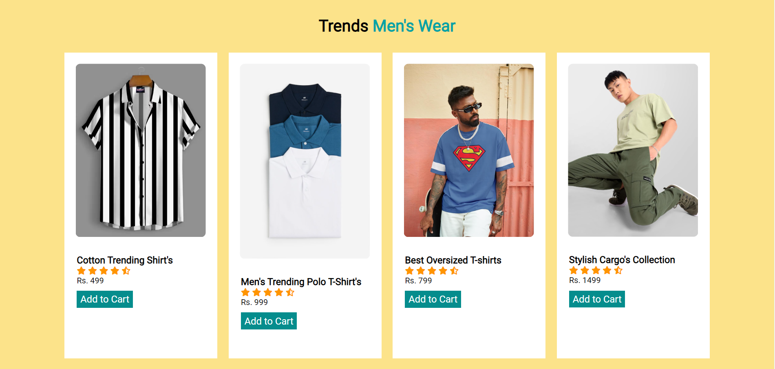
Snapshots

Slide 11
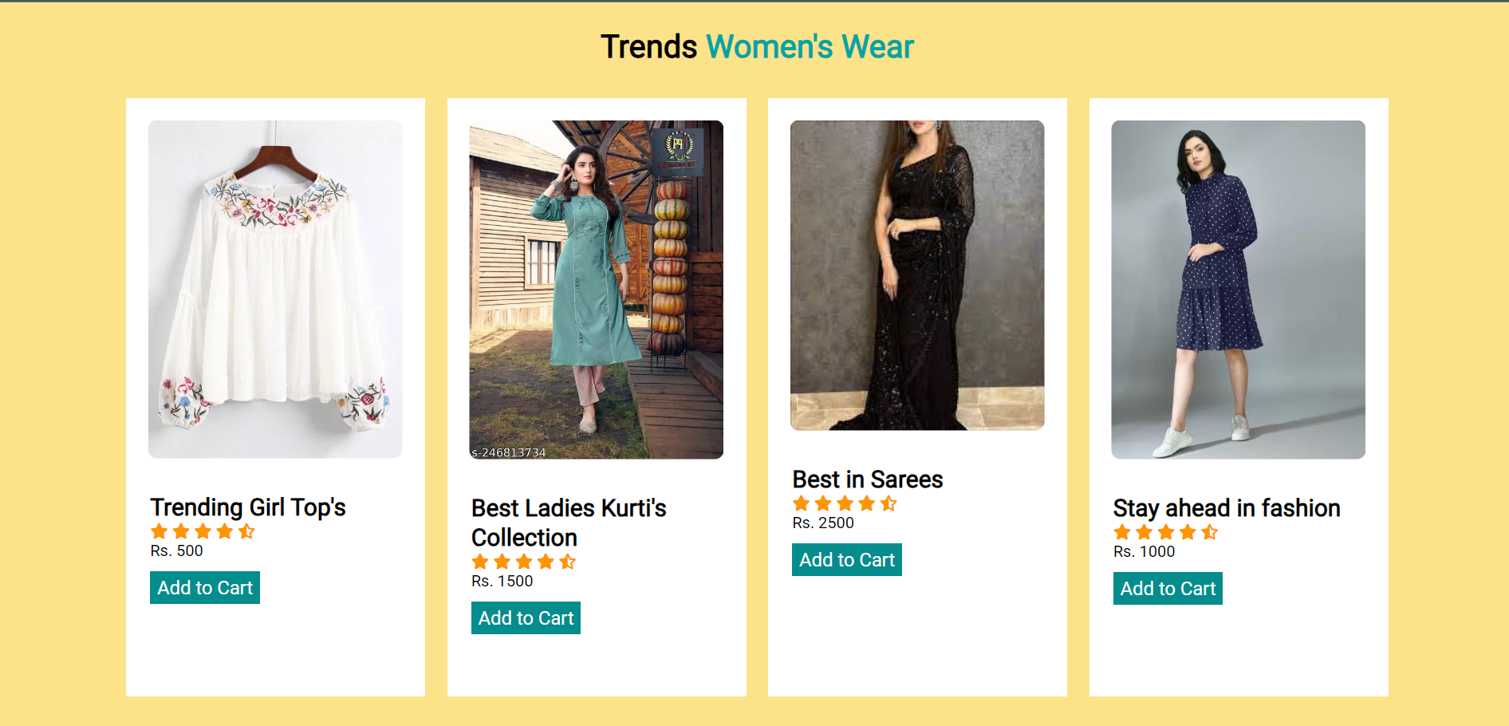
Snapshots

Slide 12
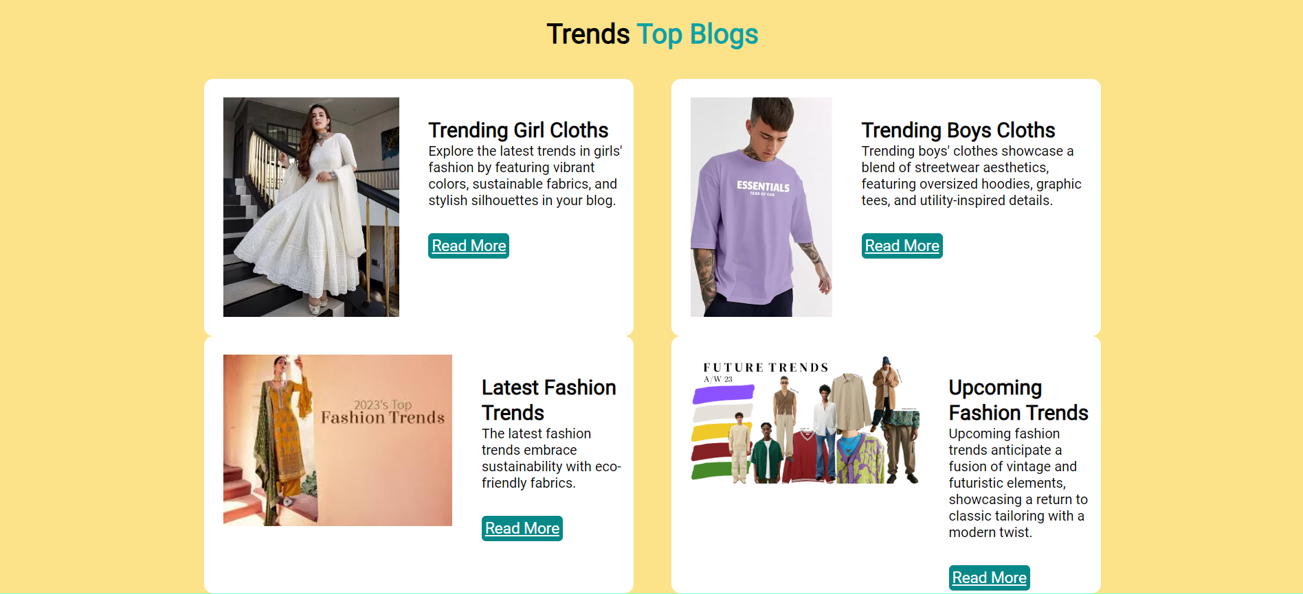
Snapshots

Slide 13
Reference
[1] E-commerce platforms like:
Amazon: https://www.amazon.in/
Flip cart: https://www.flipkart.com/
Myntra: https://www.myntra.com/
[2]Development resources like HTML, CSS, Java script, GitHub.
[3]Google for search engine.
[4] Used for icons - https://fontawesome.com/icons

Slide 14
Result
The result of the project is a fully functional and responsive online shopping platform named Trends. Users can seamlessly navigate through the website, browse a diverse product catalog, add items to their cart, and securely complete transactions. The website incorporates a visually appealing design, intuitive user interface, and essential features like user authentication, management, and order processing. With integrated payment robust security measures, and continuous improvement based on user feedback and analytics, the e-commerce website is poised to provide a positive and secure online shopping experience. The successful deployment of the project marks the realization of the defined objectives and positions the website for growth and customer satisfaction in the competitive e-commerce landscape.

Slide 15

The End

